Slide 1
Praxis of TESOL-teaching
MONASH
EDUCATION
Mervi Kaukko, Monash University/University of Oulu, Finland
VicTESOL-seminar, 14/03/2017, Bastow Institute
Notes:
Introduction

Slide 2
IN THIS SEMINAR
  Introductions
  Your views on praxis
  A glance of (educational) praxis literature
  Praxis with refugee students
  Task (research option)
  Finnish peers’ responses
  Students’ responses
Notes:
Introduction
In this seminar…
Who are you?

Slide 3
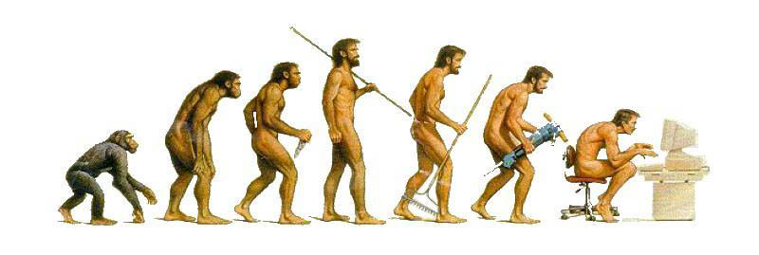
WHO ARE WE?
Notes:
Before…
Sitting down is dangerous.
Y/N questions, look around
Who is a teacher?
Who has been a teacher?
Who can speak some other language than English?
Who speaks a language other than English at home?
Who has been a EAL student in school?
Whose children have studied in a language other than their home language?
Who works with children?
Who works with adults?
Who works with refugees?
Who is interested in improving their own work?

Slide 4
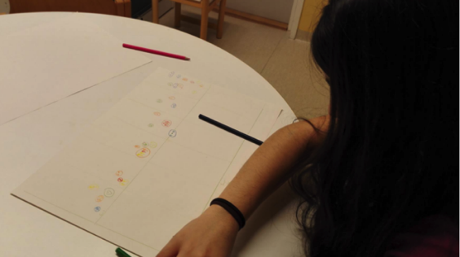
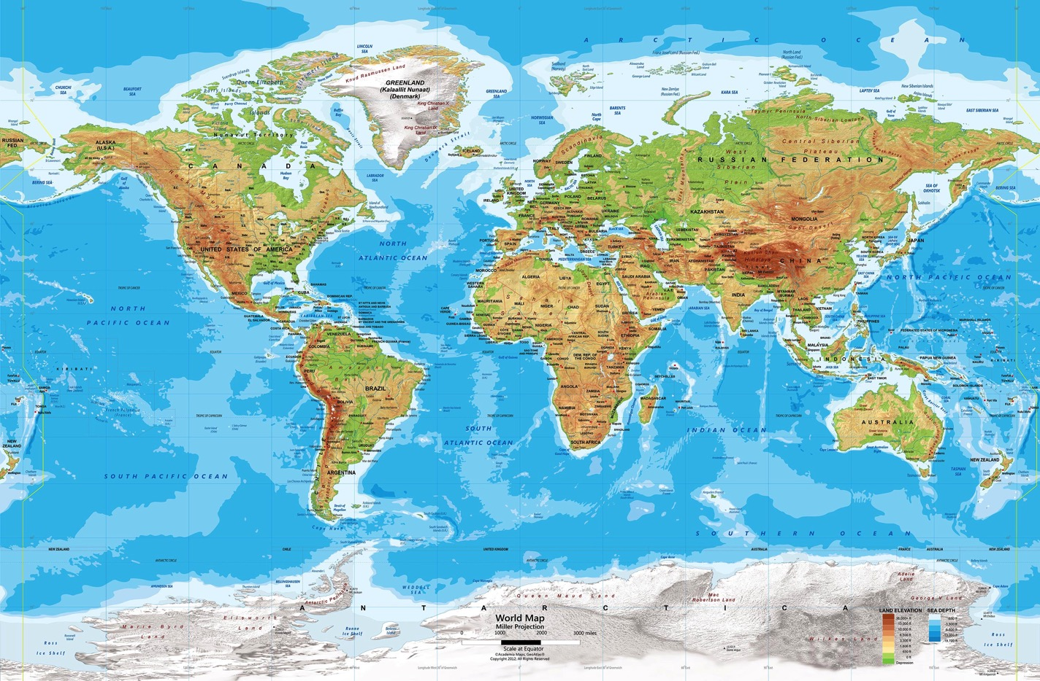
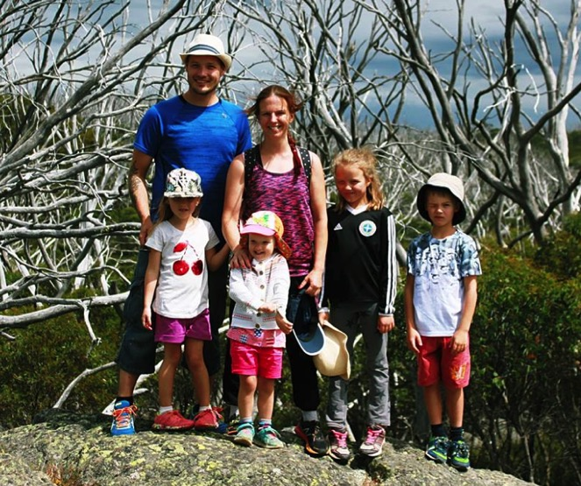
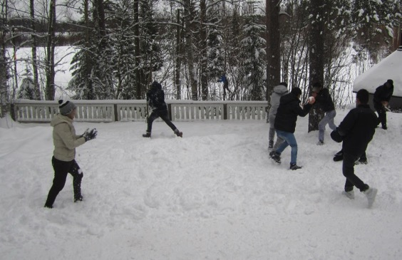
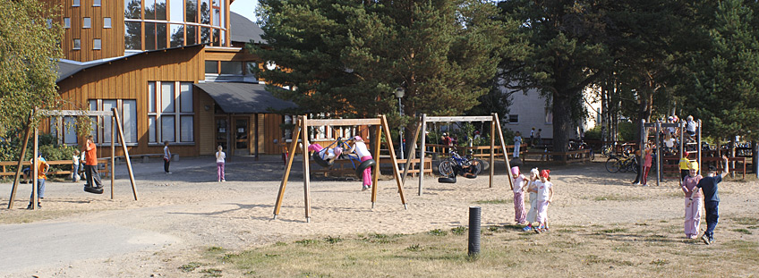
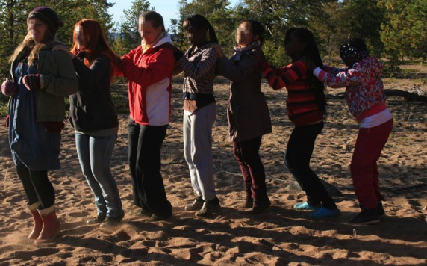
Notes:
Introducing myself
I am from Finland
I am a primary school teacher by training
Not a TESOL teacher, but the focus of my degree was intercultural or global education, as one of the focus areas of TESOL
After being a teacher, 5 years as a teacher educator and researcher at University of Oulu, mostly teaching future teachers to work with migrant children
Research, all 3
Came 2016 w family
Looking at TESOL now as a mother

Slide 5
PRAXIS IN THREE WORDS
Exploring, understanding and developing praxis (rather than practice) from the inside
Notes:
What do you think praxis is?
Think for two minutes and tell me in three words.
No right or wrong answers.
Sharing
Asking others to elaborate their answers
I summarize
Why? Because praxis cannot be changed (or understood) from the outside, but I can offer some ideas of how to do it.
You can have a spectator view on praxis, but the ones whose praxis it is have the most privileged position to explore and develop it.

Slide 6
PRAXIS
View 1: Aristotle:
Praxis as ”right conduct”; self-aware, wise and prudent action (as distinct from technical know-how or theoretical know-how)
Knowing what one is doing in the doing of it (Kemmis 2009)
View 2: Hegel & Marx:
“History-making action”: action with moral, social and political consequences, good or bad, for those involved in and affected by it. Praxis as something that actually happens.
Developed into practical wisdom or practical intelligence; or
Action
Knowledge
Reflection
Praxis
Particular kind of action that is morally-committed, and oriented and informed by traditions in the field. It is the kind of action people are engaged in when they think about what their action will mean in the world.
Praxis is what people do when they take into account all the circumstances and exigencies that confront them at a particular moment and then, taking the broadest view they can of what is best to do, they act. (Kemmis & Smith 2008,4)
Notes:
Of the most common views of what praxis is, two are related.
Sentence on Aristotle; knowledge interests
Hegel & Marx: History-making action refers to any kind of action with action with moral, social and political consequences, good or bad, for those involved in and affected by it
According to Hegel ja Marx (1845) ideas, theories and social phenomena are born in collective praxis, and it is this kind of action that makes history.
More recently…
So, praxis is always action, and it is always tied to the moment in which it happens.
That is why it cannot be taught, but talking about it can help practitioners understand their own work.

Slide 7
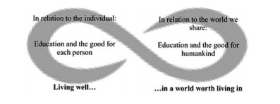
EDUCATIONAL PRAXIS
Double purpose of education: ”action that aims for the good of those involved and for the good for humankind” (Kemmis ym. 2014, 26)
Educational praxis is Aristotelian (right conduct) and post-Hegel & Marxist (reproduction and transformation of rising generation into modes of personal/moral/social/political life oriented towards good for each and all)
Anglo-American-Australian Aristotle; Europe Marx
“Realised in ethical and respectful relationships in educational encounters” (Ponte and Smit, 2016, 8); standpoint of practitioners (teachers) and their capabilities of acting autonomously and rationally, or alternatively, from the point of view of the cultural, social and political contexts in which they act.
Notes:
All praxis is not educational; not all education praxis
The Aristotelean idea of praxis was adopted to education especially at the times of Enlightenment, mainly aiming to replace a deterministic religious notions of humankind with an idea of human beings as autonomous individuals and human upbringing as a necessary human (not divine) task; it was considered to be necessary for humans because of humankind and our living well in the world, rather than because of religion
H&M did not talk about education, but you could argue that education is also history making action
If we consider the definitions of previous slide, educational praxis is both
It is Aristotelean because it aims to be “right conduct”, aiming at the good for persons and the good for humankind,
It is H&M because it aims at the reproduction and transformation of rising generation of children, young people and adults into modes of personal and moral life and modes of social and political life that are oriented towards the good for each and for all
IMAGE: Educational praxis is practical and prudent action that– at the particH&M kind of praxis was adopted especially in North and Continental Europe, including Finland, considering education broadly as brining up the child, whereas here and in other English speaking countries Aristotle. (Language, pedagogy, education)
ular moment of enactment – aims for the good of those involved (the individual, left) and for the good for humankind (the world, right) (Edwards-Groves & Grootenboer, 2015).
English-speaking world, including Australia, often draw from (and extend on, like S Kemmis as Hannu noted), Aristotle
Have you thought about this when teaching? Examples of when I have

Slide 8
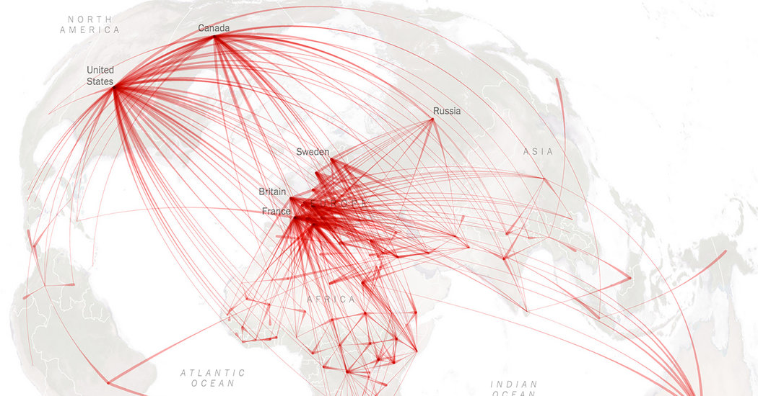
WHY NOW?
New normal poses the question of where to go and what the world worth living in means
Open racism, anti-educational views also turned into new normal
The philosophers have only interpreted the world in various ways; the point is, to change it. (Bernstein 1972, 13)
Educators and educational researchers as change-agents
Schooling vs. education
More than technical or theoretical knowledge; not only good education but education that will do good
Notes:
Any ideas of why considering praxis could be important especially in this historical moment we live in?
I think it is important because…
The argument-making purpose of both education and research has been talked about for a long time, and I think the quicker the changes are, the more we should make education react to it.
I think it is needed to do something which is education rather than schooling
(how does it work within strict guidelines and curricula?)
Even though enlightenment is quite a long time ago and in most nations education is not considered important anymore only because of religion, current affairs have made praxis more important.
(Trump, DeVos push private education, school vouchers and especially religious schools making education a privilege of few, and those with the right kind of faith)

Slide 9
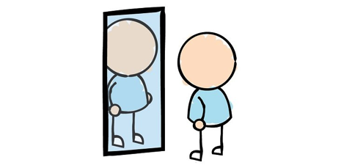



PRAXIS AS A TRIANGLE OF PRACTICE
Level 3: Considering ethical and moral dimensions
Level 2: Learning, planning, reflecting.
ABC
Level 1: Acting
Adapted from The Practice Triangle in Handal & Lauvås 1987
Notes:
Talking about praxis and its significance is one thing, we have to make it work
Many ways to do that, one suggestion is by…
The argument is that our work is at least action; and the action is tied within a temporal and spatial event, and our judgement of what is best in that situation
It is enabled or hindered by material, semantic and social conditions
We base our action on knowledge of what might work, and knowledge of what our work should include.
So it is both knowing how and knowing to
Some of the knowledge is acquired formally, through initial and continuous education and other external sources, and some informally, through action and experience
Our work is also reflection on what we have done and how it went
In many sessions of professional development teachers get help in the first and second level.
Our focus is (hopefully) mostly on the third level, and the way it dripples down effect on the levels 1 and 2.
It is not necessarily a triangle: it might be turned upside down: (what comes first, practice or knowledge?) → funnel parallels
Then we look at what praxis might be when working with refugee students.

Slide 10
Praxis with refugees
Notes:
I know not all of you teach refugees, but pretty much all refugees are speakers of other languages.

Slide 11
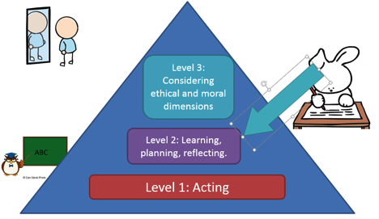
WHAT DO WE KNOW ABOUT REFUGEE EDUCATION?
Pre-migration experiences (role of school: UNHCR 2016; any kind of interventions: Ager et al 2011)
Stage of transition (belonging, structure: Kohli 2011; Hirsch & Maylea 2016;
Kia-Keating & Ellis 2007)
Adaptation
(child-centredness, whole-family approach, suitable level of difficulty, Brennen & Kia-Keating 2016; Pastoor 2015, 2016; Graham et al 2016)
Safety
Belonging
Success
Critical transitions, each with different priorities for teachers to consider
Aspirations, engagement, optimism often high (not always matching the conditions)
Socioecological conditions
This is what we think we know, but how this is known? And what can be done with this knowledge?
Notes:
So, this is an example of what the action and knowledge parts of triangle on refugee children might be
We know that
In countries of origin… If there has been anything educational, the initial steps have been “schooling” (activities that routinely go on in schools) if they have had access to it, whereas their school journeys should develop in to “education”.
In the initial stage of transition…
In adapting…
Although the starting points of refugee students differ in many ways, there are many pre- and post-displacement risk-factors that can pose challenges for the refugee students’ adjustment to formal education in their host countries.
Some of the challenges have been explained by trauma, gaps in education and other factors related to the students’ background (Graham et al, 2016; Brenner & Kia-Keating 2016), whereas other reasons point to the poor educational arrangements in the host countries.
Not this simple
So this is WHAT we know, but how do we know this?

Slide 12
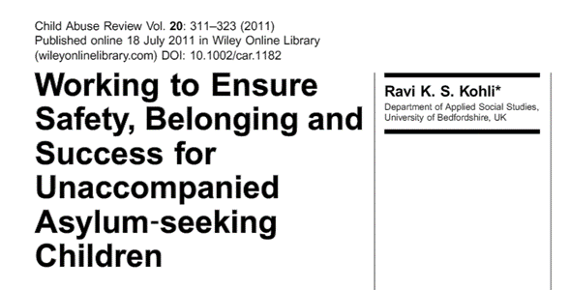
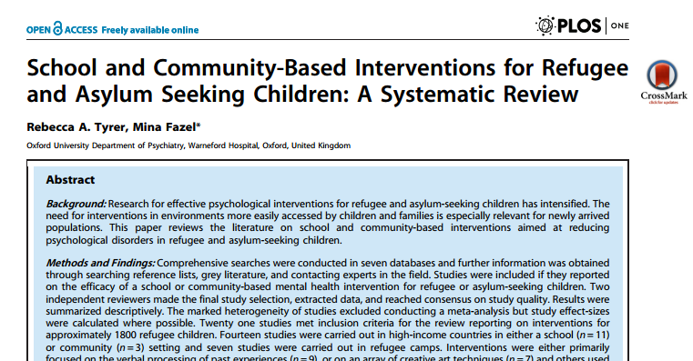
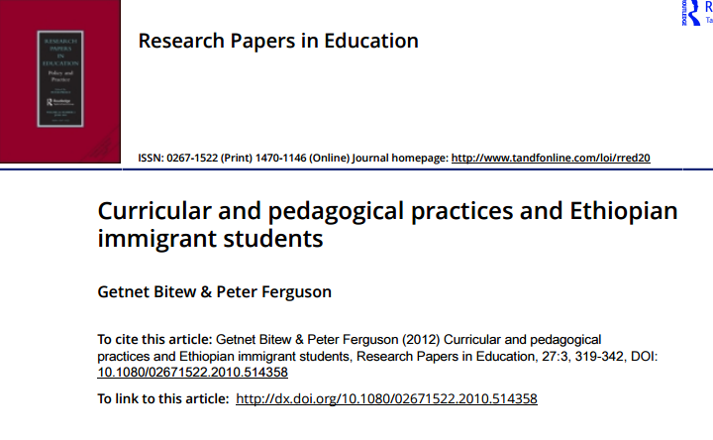
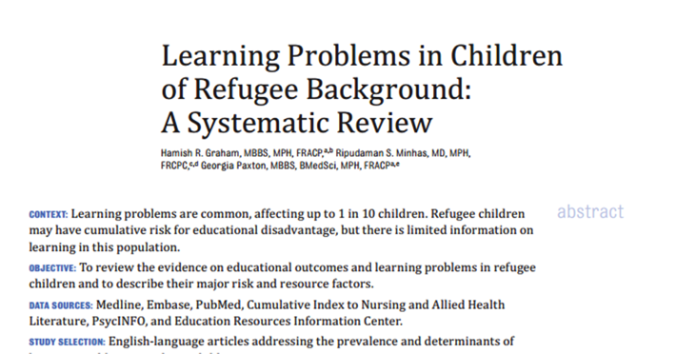
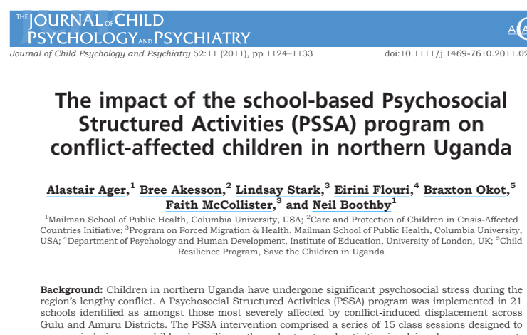
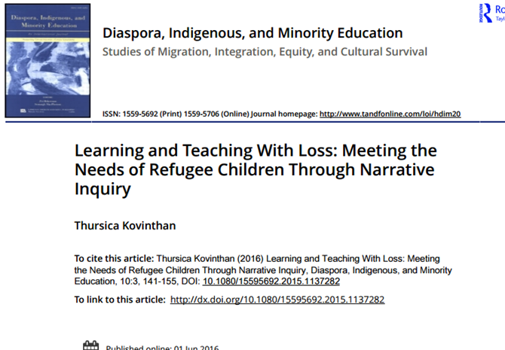
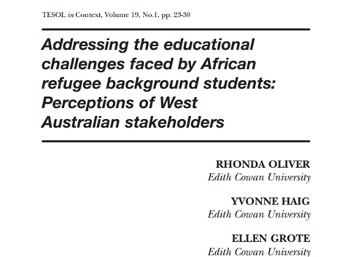
HOW DO WE KNOW IT?
PRAXIS?
Notes:
We know this because of mostly quantitative research with measurable effects, and clinical tests.
Focus on schools as remedial places, or interventions of what might work to change some kind of outcomes.
Not to say this research is not good.
I also do not say this research does not inform praxis; it might tell what could be improved in the conditions in which teachers and students work in.
This research just leaves the child or the practising teacher with a very little voice.
If we want to start from the needs of students, and be responsive to that, what does that mean?

Slide 13


HOW DO WE ACT WITH REFUGEES
How to ensure “ethical and respectful relationships in educational encounters” (Ponte and Smit, 2016, 8) without assumptions?
How to aim for a good life despite of difficult starting points (interrupted education and language barriers) and many uncertainties in the future?
What is living well and a world worth living in?
How to agree on what is good?
Notes:
What does wise and prudent, history-making action mean for teachers who teach recently arrived refugee students?
How can teachers prepare children for the future which is often very uncertain, especially for asylum-seeking children with unsolved cases, or whose understandings of “good life” or desirable future are influenced by their past experiences, such as the flight from the home country, interrupted education, multiple language transitions
and possible past experiences of trauma ?
What kind of good life is possible when relocation and settlement bring stressors which schools cannot influence, as families often face poverty, housing stress, food insecurity and discrimination, and all this with limited social supports and within unfamiliar social structures?
Also, good is always contested, it must be always re-determined for changing times and circumstances, and that what is good for a any person or group to do in any particular historical moment is impossible say. Alternatives cannot be seen.
This applies to education in general, not only refugees.
So, how to ensure that teaching is in line with this image?
I don’t have answers but would like to hear your views

Slide 14
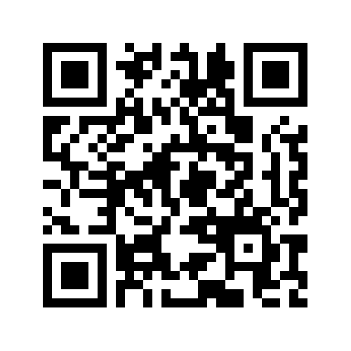
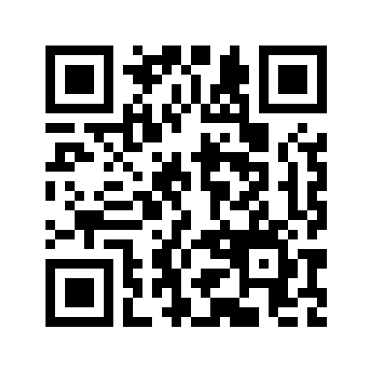
TASK
Do you teach immigrant/refugee students?
Yes
Can I use your anonymous responses for teaching and research?
No
Yes
No
Notes:
Explanatory statements to see
Consent forms to sign
If somebody wants results when finished, leave email address

Slide 15
LINKS
Yes to research: https://padlet.com/mervi_kaukko/2dve88lpzxcw
No to research: https://padlet.com/mervi_kaukko/lti9wzivplt9

Slide 16
TIME TO SHARE

Slide 17
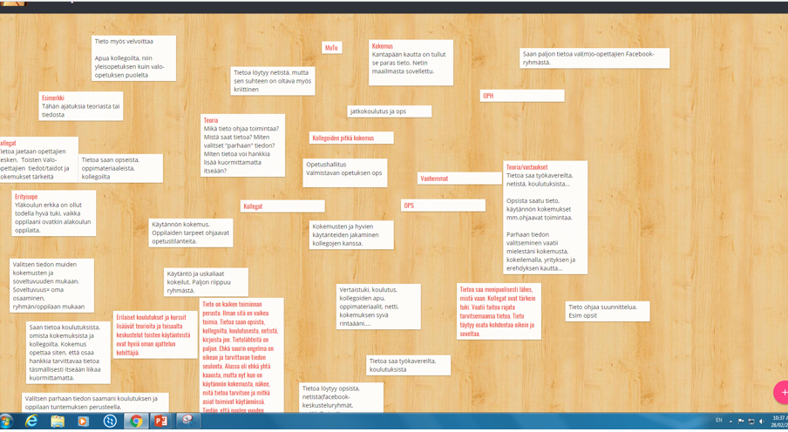
WHAT DID YOUR FINNISH COLLEAGUES SAY?
Notes:
From Finnish colleagues who gave consent for this

Slide 18


IN SUMMARY
Knowledge:
Action:
Reflection:
Formal knowledge: continuing education, curricula, literature, multi-professional teams; Informal: sharing experiences with colleagues (also in Facebook groups), trusting own gut feeling
Action: Flexible, student-centred, surprising
Reflection: Constant, immediate reflection and reaction in class, more during long drives home
Notes:
Edit!

Slide 19


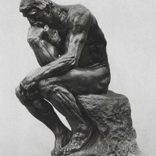
Knowledge is the basis for all action. Without it, how can you act? I gain knowlege from curriculum, colleagues, education, Internet, books, ect. There are plenty of sources for knowlege. Perhaps the biggest problem is how to select the accurate and relevant knowledge. Everything was chaotic in the beginning. Now, with practical experience, I can see what kind of knowledge I need and what kind of activities work in practice.
As a starting point is the Preparatory Teaching Curriculum, which we all love so much. Having studied this and that helps to glue the taught phenomena together. All need to be adapted to be child-centred. And for that, you need good student-knowlge. You need to be flexible and steer own teaching based who you teach.
Reflection is continuous, because the group is so impulsive. Teacher needs to react quickly. The programme of the day is in my head and it lives with the situations. It is the bread and butter of this work, but it is also draining. It means that you have to cope with the feeling of inadequacy, and have mercy for yourself.
Notes:
Knowledge, how to select, how choosing becomes easier with experience
Tools for action (both good and bad), need adaptation
Reflecting also negative experiences helfpul

Slide 20
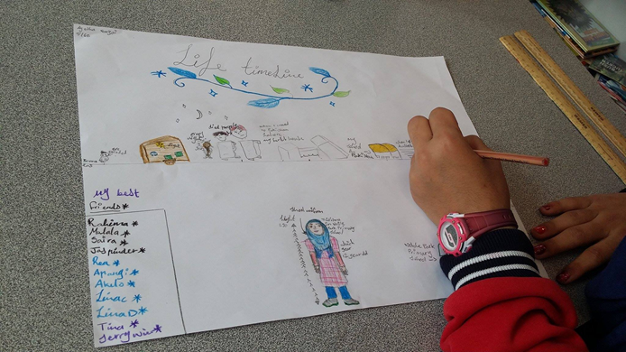
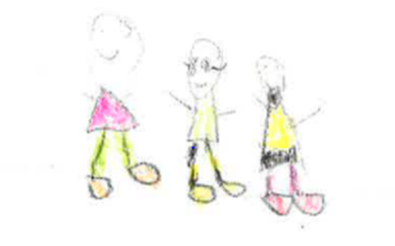
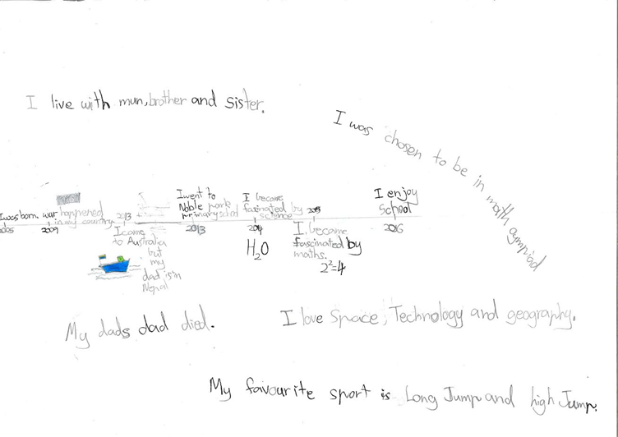
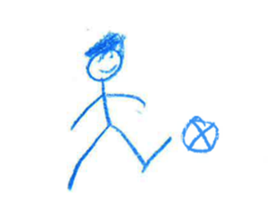

WHAT DID STUDENTS SAY?
Notes:
Method

Slide 21
LANGUAGE
Like if some people come from Spain and then if there’s another boy from Spain they should tell them to explain it to him and make sure he understands. Sometimes I didn’t understand everything but they didn’t explain it, so yeah. They should ask him everything if he understands that. Tell them to write more because if you write a lot and then you can understand.
They should, you know how people, some people, they shy. They don’t do anything. And yeah, they should help them, and they say they should tell their best friend or something like that, to talk to them. And, yeah.
So, they [speakers of other languages] do not need a lot of extra attention. But when they do not understand something, you should keep repeating, even 100 times if they need that. Then they get it. And even from somebody who do not speak very well, the teachers should ask how they are dong. Like are they being bullied outside. If she doesn’t tell you, you should keep asking that are you really OK. Because she might be afraid to tell you.
Notes:
Students talked about all kinds of things, but knowing your interest in language, I choose some quotes that illustrated how their own learning practices, school wellbeing and practices of others were defined by language
Themes that emerged a lot

Slide 22
LANGUAGE
Peer support
Like if some people come from Spain and then if there’s another boy from Spain they should tell them to explain it to him and make sure he understands. Sometimes I didn’t understand everything but they didn’t explain it, so yeah. They should ask him everything if he understands that. Tell them to write more because if you write a lot and then you can understand.
They should, you know how people, some people, they shy. They don’t do anything. And yeah, they should help them, and they say they should tell their best friend or something like that, to talk to them. And, yeah.
So, they [speakers of other languages] do not need a lot of extra attention. But when they do not understand something, you should keep repeating, even 100 times if they need that. Then they get it. And even from somebody who do not speak very well, the teachers should ask how they are dong. Like are they being bullied outside. If she doesn’t tell you, you should keep asking that are you really OK. Because she might be afraid to tell you.
Writing, reading
Being like anybody else
Language & wellbeing
Notes:
Students talked about all kinds of things, but knowing your interest in language, I choose some quotes that illustrated how their own learning practices, school wellbeing and practices of others were defined by language
Themes that emerged a lot

Slide 23
WHAT A GOOD TEACHER DOES…
…WHAT MAKES A GOOD TEACHER?
You know how we do maths here and stuff? They actually, they say “Do you understand?” and then they ask me every time, like “Do you understand?” and then when I get to Year 6 they don’t say because I do understand. But in Year 5, yeah, they ask me and then when I say no they actually explain that, so yeah, I knew what I was going to do.
This teacher (in picture), she was nice. She always said I can become better, become better. Then I believed her and became better. She was nice. I liked her.
When people do something wrong to you, she supports you and stuff. So that you are not afraid to tell her. --- Like she believes and stuff. And smiles and does not look angry.
A good teacher teaches, like when we get something wrong, they don’t go like [frowns], like they teach, “You did this wrong. You had to do this, that.”
[Teacher] was also nice. She was kind. She made me calm down. When somebody bullies or fights, she made us calm down. Not with a ruler but because she was kind.
This school, in this school they don’t actually hit, they actually help, so that’s what I wanted. And yeah, I didn’t do things, so I just let the teachers.
Notes:
As I know TESOL teaching is not only language, I thought you would want to know other issues about what a good teacher does, and what makes a good teacher.
Here is more
(let read)
I think this applies to all teachers, TESOL and other
Some of teachers teaching
We do not have time to go through everything the children said, so we will focus on their views of good teacher. Many of them are very close to the views on praxis I have, and perhaps you share.
Some are both: not hitting is about what teacher does (not do), but also what teacher is not: a monster

Slide 24

WHAT A GOOD TEACHER DOES…
…WHAT MAKES A GOOD TEACHER?
You know how we do maths here and stuff? They actually, they say “Do you understand?” and then they ask me every time, like “Do you understand?” and then when I get to Year 6 they don’t say because I do understand. But in Year 5, yeah, they ask me and then when I say no they actually explain that, so yeah, I knew what I was going to do.
This teacher (in picture), she was nice. She always said I can become better, become better. Then I believed her and became better. She was nice. I liked her.
When people do something wrong to you, she supports you and stuff. So that you are not afraid to tell her. --- Like she believes and stuff. And smiles and does not look angry.
A good teacher teaches, like when we get something wrong, they don’t go like [frowns], like they teach, “You did this wrong. You had to do this, that.”
[Teacher] was also nice. She was kind. She made me calm down. When somebody bullies or fights, she made us calm down. Not with a ruler but because she was kind.
This school, in this school they don’t actually hit, they actually help, so that’s what I wanted. And yeah, I didn’t do things, so I just let the teachers.
Aims for reciprocal understanding
Believes in the child
Kind
Notes:
(let read)
(colour coded analysis of what they might mean), and I think this applies to all teachers, TESOL and other
Some of teachers teaching
We do not have time to go through everything the children said, so we will focus on their views of good teacher. Many of them are very close to the views on praxis I have, and perhaps you share.
Some are both: not hitting is about what teacher does (not do), but also what teacher is not: a monster
Practices are interconnected, teachers show example of how others are treated
You have a big role

Slide 25

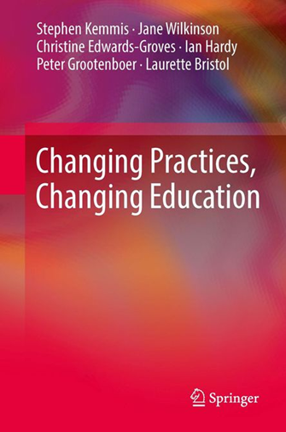
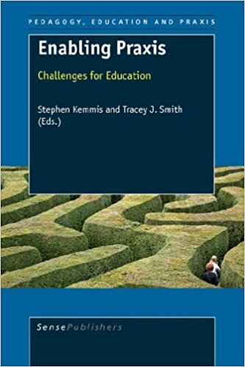
HOW TO DEVELOP OWN WORK?
Notes:
There is definitely not a shortage of sources.
Also, online sources
I say this even though I know many practitioners in education feel that their views are not encounter in educational research, and that research fails to recognise their interpretative categories, lived realties and their experience (speaking about them)
It is possible to understand and develop the ways in which practices are conducted within practice traditions that inform and orient them
It is possible to enter critical dialogue with those who speak the language and constitute the shared practice
Praxis-literature

Slide 26

REFRENCES
Bernstein, R. J. (1972). Praxis and action. London: London, Duckworth.
Bristol, L. S. M., Ponte, P. & Wilkinson, J., editors. (2016). Professional development : Education for all as praxis Abingdon, Oxon : Routledge.
de Wal Pastoor, L. (2014). The mediational role of schools in supporting psychosocial transitions among unaccompanied young refugees upon resettlement in Norway. International Journal of Educational Development, doi:10.1016/j.ijedudev.2014.10.009
Graham, H., Minhas, R., & Paxton, G. (2016). Learning problems in children of refugee background: A systematic review doi:10.1542/peds.2015-3994
Handal, G., & Lauvas, P. (1987). Promoting reflective teaching. Milton Kaynes, SRHE.
Hirsch, A., & Maylea, C. (2016). Education denied: People seeking asylum and refugees trapped in limbo. New Community Quarterly Journal for Social Justice, Sustainability, Community Development and Human Rights, 14(55), 19-24.
Kemmis, S. (2010). Research for praxis: Knowing doing. Pedagogy, Culture & Society, 18(1), 9-27. doi:10.1080/14681360903556756
Kemmis, S., & Smith, T. J. (2008). Enabling praxis : Challenges for education. Rotterdam, The Netherlands: Rotterdam, The Netherlands : Sense Publications.
Kemmis, S., Wilkinson, J., Edwards-Groves, C., Hardy, I., Grootenboer, P., & Bristol, L. (2014). Changing practices, changing education. Singapore: Springer.
Ponte, P., & Smit, B. H. J. (2013). Education for all as praxis: Consequences for the profession. Professional Development in Education, 39(4), 455-469. doi:10.1080/19415257.2013.796296
Notes:
references

