Slide 1

TEAL Assessment Tasks
Janet Saker
Alan Williams
(TEAL Project Team)
http://teal.global2.vic.edu.au/

Slide 2
What is TEAL?
Tools for Enhancing Assessment Literacy for Teachers of EAL students
Web-based assessment resources
Provides a range of tools and resources to assist teachers to assess ESL/EAL student progress in Reading, Writing and Speaking and listening
To assist teachers to make and to validate assessments on the EAL Companion to AusVELS and the EAL Developmental Continuum (and which will link to new VCAA EAL curriculum when finalised).
To assist teachers to find out the learning needs of their students.
Provide advice and guidance on using assessment for learning to enhance EAL teaching

Slide 3

Notes and videos with information for teachers on assessment of EAL learners
Oral task and annotations,
Writing tasks and annotations,
Reading and vocabulary tasks
Units of work developed by teachers, exemplifying AfL principles for EAL learners

Slide 4
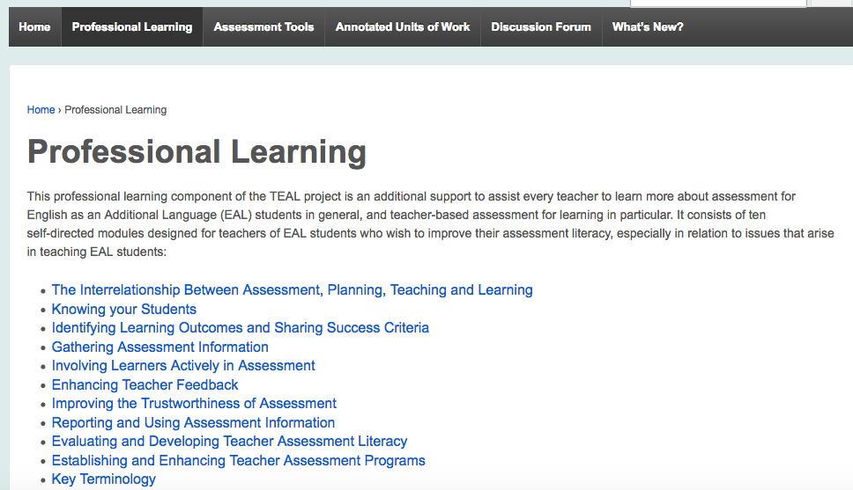
Self-Directed Professional Learning Modules
10 modules on topics related to assessing EAL learners.
Each module contains:
• Self-reflection (to get started)
• Input (information, ideas, strategies)
• Reading and resources (links)
• Follow up (applying input to your context)
Some modules have other content,
e.g. the Reporting module includes
sample reports
Use these for individual study or group discussions and learning.
Form the basis for the TEAL PD which will be offered this year

Slide 5

Using the assessment tools
Hold mouse over menu bar for links to:
• TEAL writing tasks
• TEAL oral tasks
• Reading and Vocab Assessment Tool (RVEAL – coming in term 1, 2017)
• Other useful assessment tools (additional tools that may be of use, e.g. writing task observation sheet)

Slide 6

Advice about selecting and using oral tasks
Information and advice to
enhance your use
of the tasks, including a
plain language Glossary
Access list of oral tasks here!

Slide 7
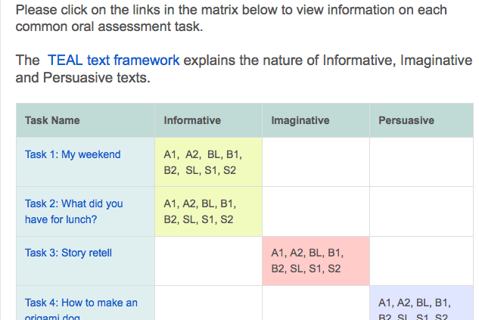
Task matrix to assist selection
Use the overview of tasks
to select the tasks most appropriate
for your students.

Slide 8
TEAL Project: Assessment tasks
Characteristics of tasks:
Range of text types: informative, imaginative, persuasive
Oral – Range of interaction: listening and responding, interaction and negotiation
Range of discourse contexts: with teacher, in pairs, in a small group, presenting to a group
Writing – Range of kinds of texts: instructions, retell, descriptions

Slide 9
TEAL Common Assessment tasks
What are TEAL common assessment tasks?
Tasks, based on typical classroom activities, that can simply be used with individual (or small groups) of students.
Why common assessment tasks?
Assessment tasks that have been used with other students, can be compared with performances of other students.
There will be some commonality in student responses, which can be ordered to show a progression of achievement, in a range of aspects.

Slide 10
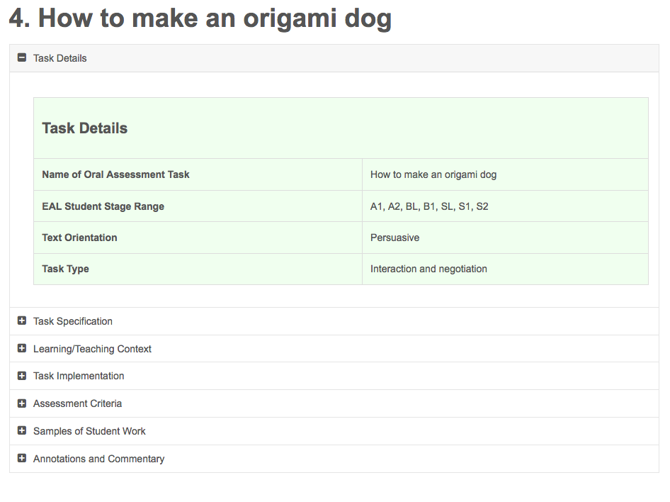
Details of each task
Click on each toggle to see:
information about the task
how to implement it
assessment criteria
student samples
commentary on the samples
the assessed EAL stage of the sample .

Slide 11
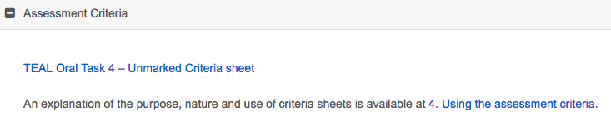
Criteria sheets for each task
4 levels of performance, and statement of approximation of each level of performance with AusVELS stages
The criteria are organised following the structure of the EAL Developmental continuum, with a further break down of the Linguistic structures and features strand

Slide 12
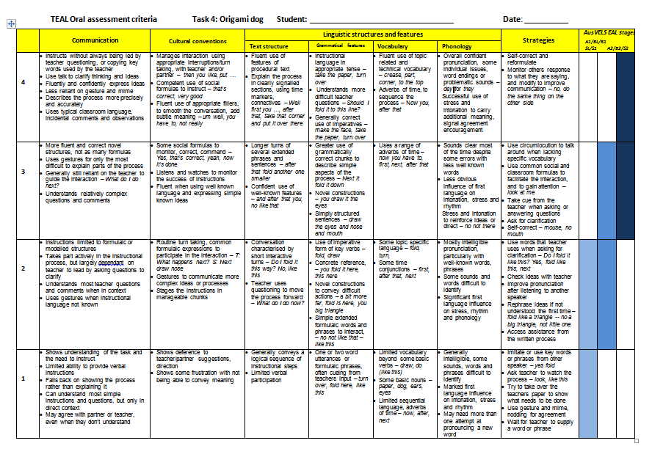
Sample unmarked task criteria sheet

Slide 13
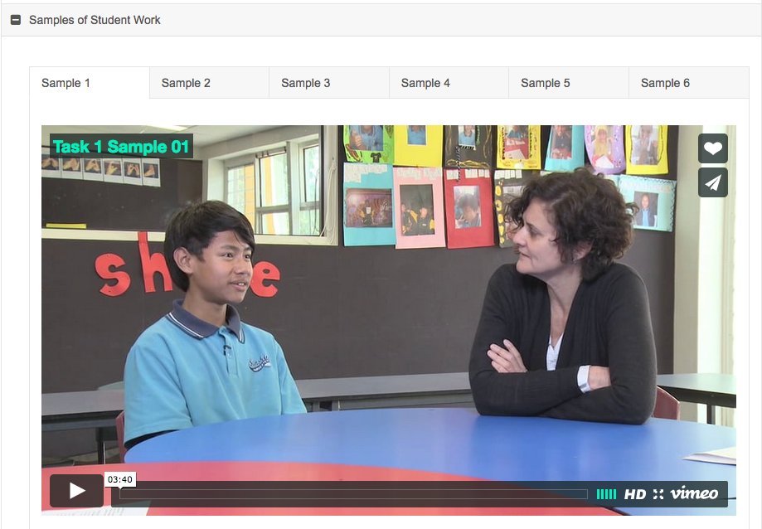
Samples: Videos of oral tasks
A selection of videos of students performing the task – usually 4 or 5 videos, 3 to 5 minutes each
Arranged as much as possible in order of overall level of performance of the task (basic to more accomplished)
Click on tabs to see different samples.

Slide 14
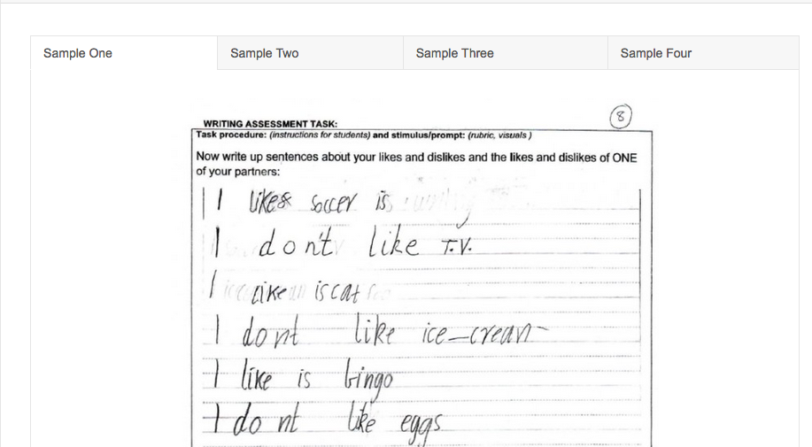
Writing samples
Click on tabs
To see different
samples
The videos and the unmarked writing samples can be used to make your own assessments, or as a moderation exercise for a group of teachers.

Slide 15
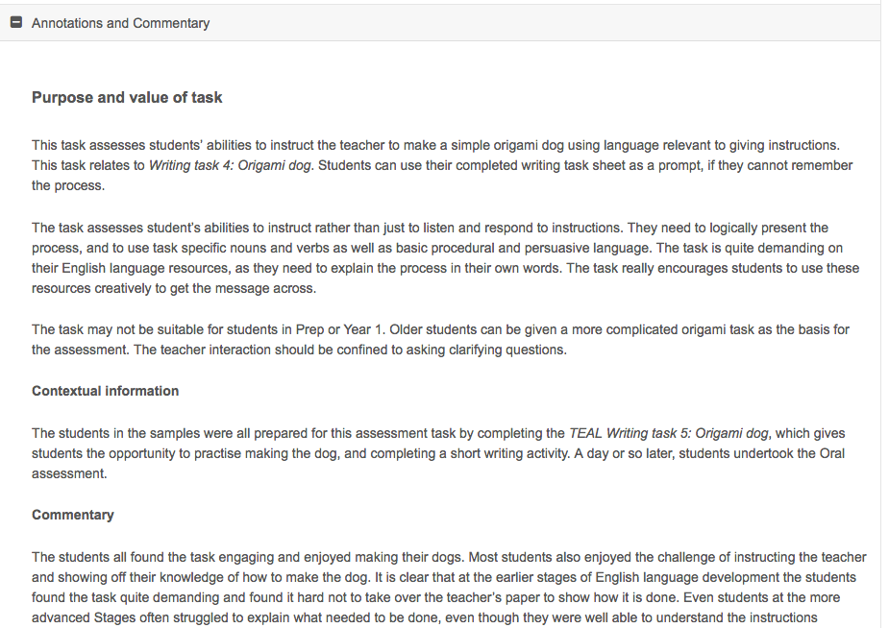
Annotations and commentary
The annotations discuss:
The purpose and value of the task for assessment
Contextual information about the samples
Commentary (summing up the range of the samples, and how students approached the task)
General commentary about
all the samples.

Slide 16
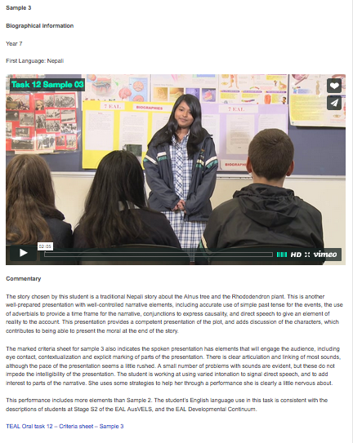
Annotation and commentary for each sample
Each sample has its own commentary which includes:
• student’s year level and L1
• specific comments about the performance of the task
• statement of how the performance relates to AusVELS EAL stage descriptors
• link to a marked criteria sheet for the student’s performance of the task

Slide 17
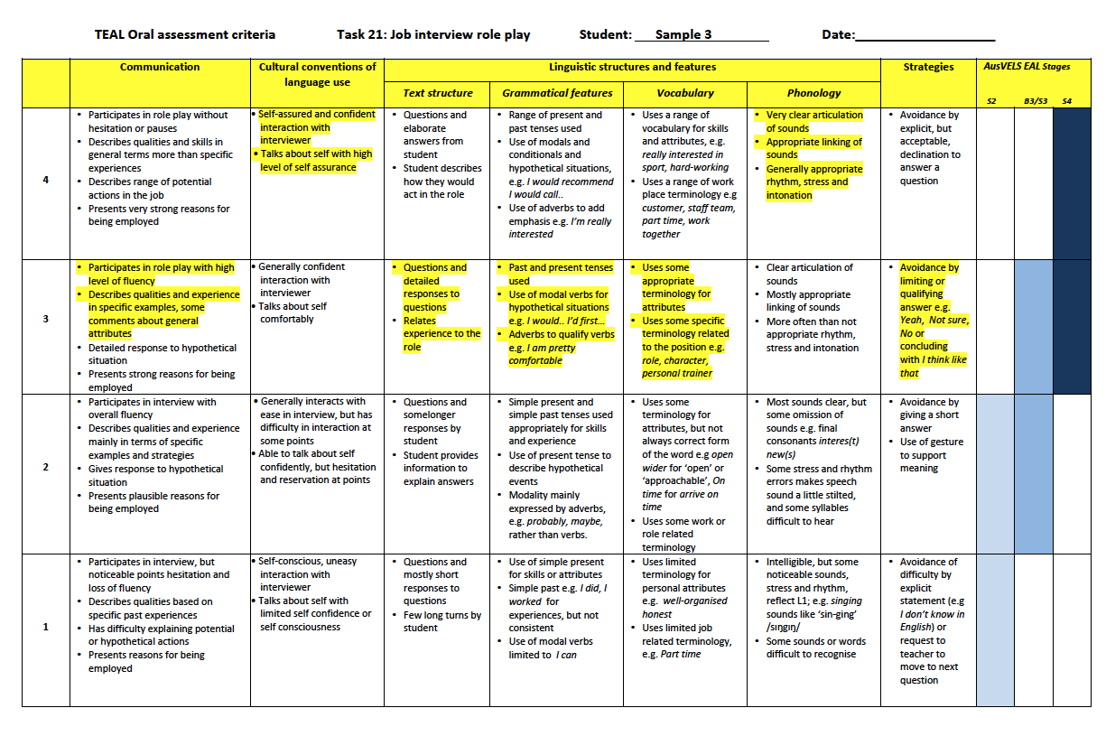
Marked criteria sheet
Students may perform at different levels in
different dimensions.
Several tasks and classroom observations are needed to come to a final ‘on-balance’ decision about which Stage the student is working at.

Slide 18
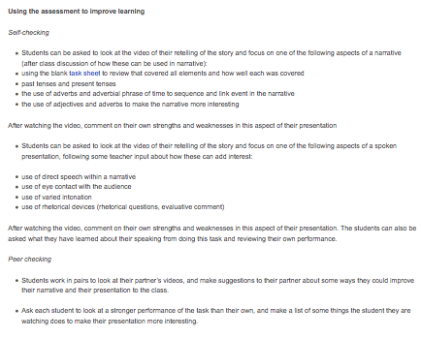
Using the assessment to improve learning
Follow-up strategies to improve student learning,
using assessment for learning principles:
Providing feedback that moves learning forward
Activating students as the owners of their own learning
Activating students as instructional resources for one another

Slide 19

Units of work

Slide 20
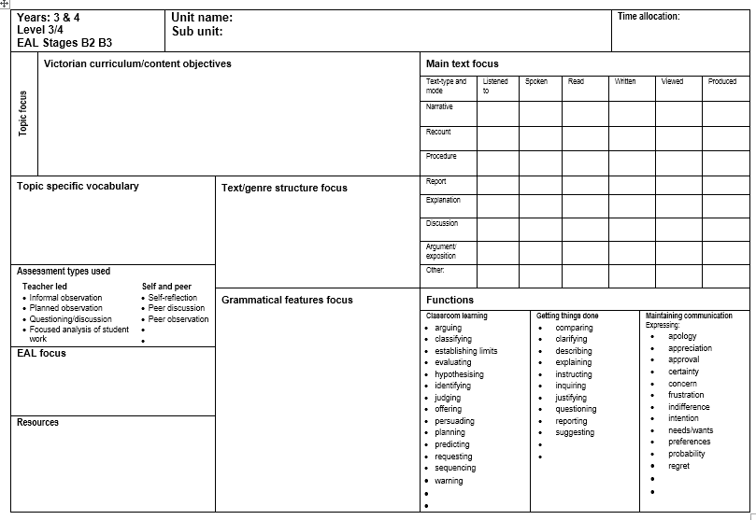
Overview of the content (subject
matter and language) of the unit of work

Slide 21
The Unit of work templates were first developed for the Victorina ESL Course Advice project, and has been updated for the TEAL project. The unit planners:
can be used to plan for a mainstream class, which includes EAL learners, or for an EAL specialist class
assist teachers in writing units of work that are more supportive of EAL learners, by teasing out more explicitly the English language demands of particular activities and text types
Focus on assessment for learning activities.

Slide 22
Questions and reflection
Any more questions?
How could you use the TEAL resources to improve your assessment practices and your students’ learning?
How could you use the TEAL resources to enhance school-wide assessment of EAL students?

